Slide 1
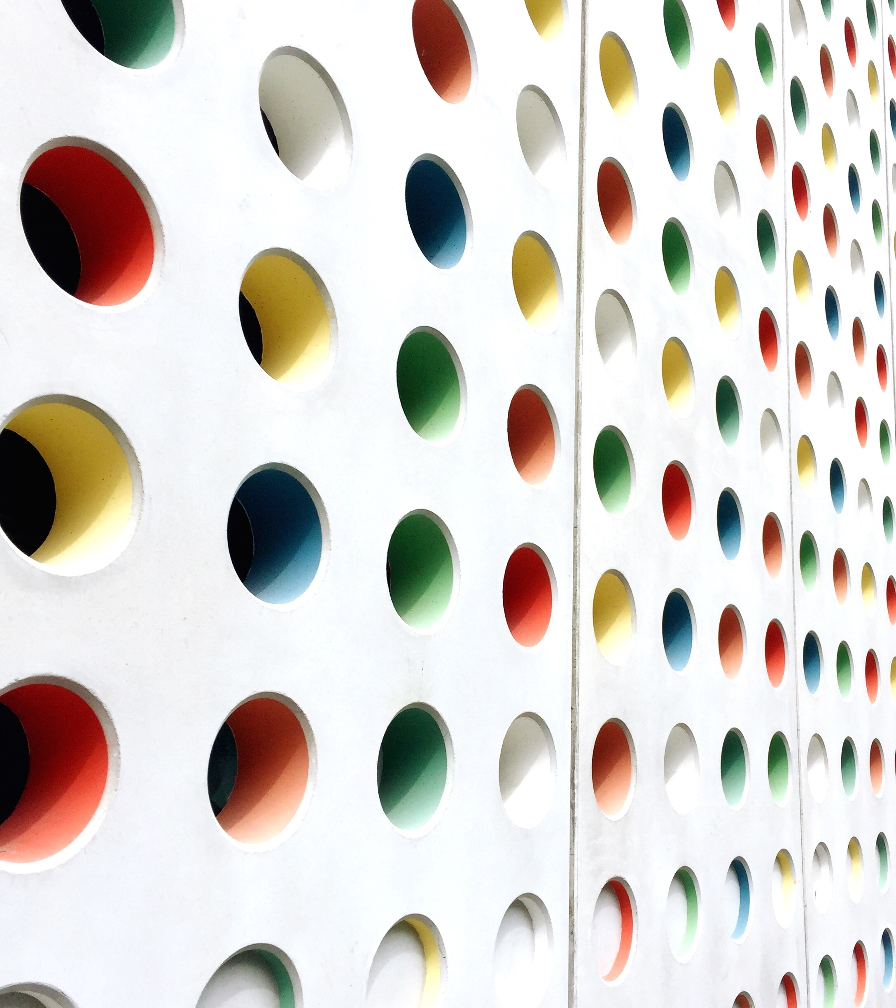
Restaurant Management System
BY:ANERI BHAVSAR
ENO:21162121003
SEM-2
BDA
BATCH-22

Slide 2
Restaurant Management System
This Restaurant Management System includes the management of information of :
Varieties of vadapaw and other items
In this management system I have used the concept of: STRUCTURE
DMA

Slide 3
DMA(DYNAMIC MEMORY ALLOCATION)
Memory allocation
Reserving or providing space to a variable is called memory allocation. For storing the data, memory allocation can be done in two ways -
Static allocation or compile-time allocation - Static memory allocation means providing space for the variable. The size and data type of the variable is known, and it remains constant throughout the program.
Dynamic allocation or run-time allocation - The allocation in which memory is allocated dynamically. In this type of allocation, the exact size of the variable is not known in advance. Pointers play a major role in dynamic memory allocation.

Slide 4
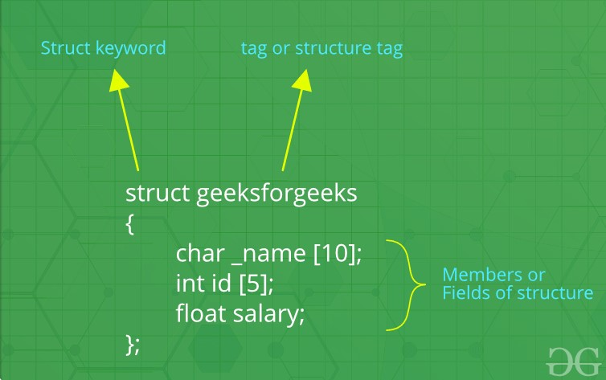
STRUCTURE:
A structure is a user-defined data type in C/C++. A structure creates a data type that can be used to group items of possibly different types into a single type.

Slide 5
HEADER FILES WHICH ARE USED
#include <iostream>: the header file which contains all the functions of program like cout, cin etc.
#include <stdlib.h>:functions involving memory allocation, process control, conversions and others.
#include <string.h>: contains macro definitions, constants and declarations of functions and types used
#include <time.h>: contains definitions of functions to get and manipulate date and time information.
#include <cstdio>:The cstdio header file contains definitions for C++ for performing input and output.

Slide 6
THE FUNCTION IN THE PROJECT
1)Total Cash Today
2. View Card Pay
3. Add Vadapav Item
4. Delete Item cout
5. Instant Item List
6. Item Counter
7. Backup System;
8. Instant Order Preview
0. Main Menu

Slide 7
}
void welcome()
{
system("clear");
cout << "\t\t\t-------------------------------------------------------\n";
cout << "\t\t\t Welcome To Mumbaiya Misal & Vadapav\n";
cout << "\t\t\t Make Your Own\n";
cout << "\t\t\t-------------------------------------------------------\n";
}

Slide 8
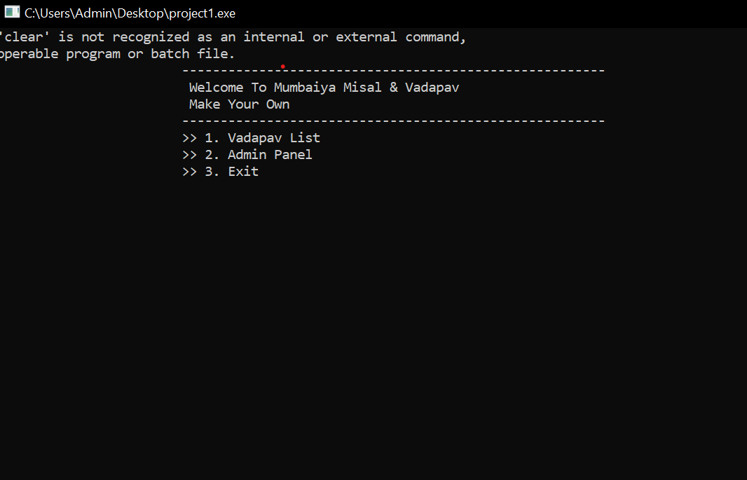
MENU DRIVEN:

Slide 9
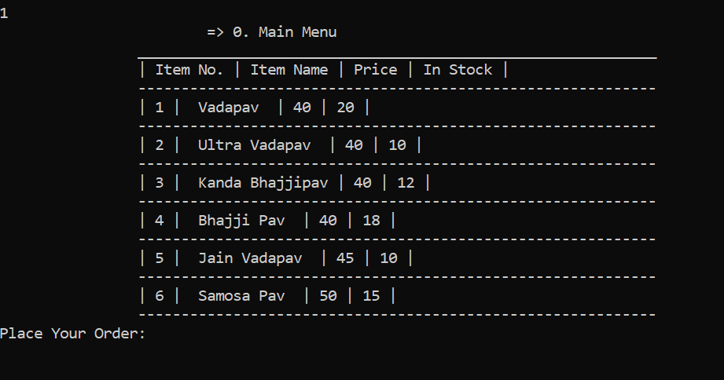
MAIN MENU:

Slide 10
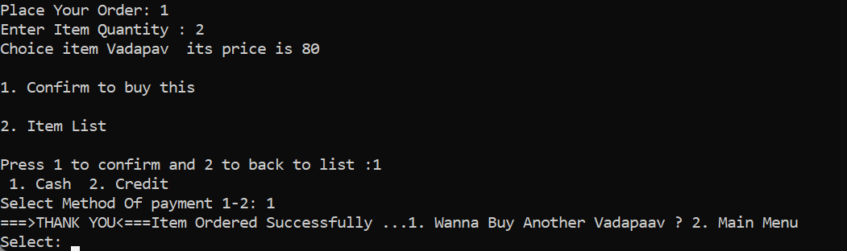
ORDER PLACEMENTE AND PAYMENT METHOD:VIA CASH

Slide 11
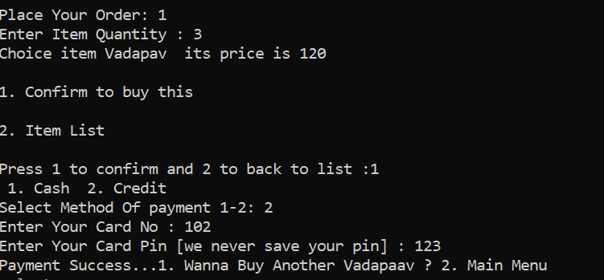
VIA CREDIT CARD

Slide 12
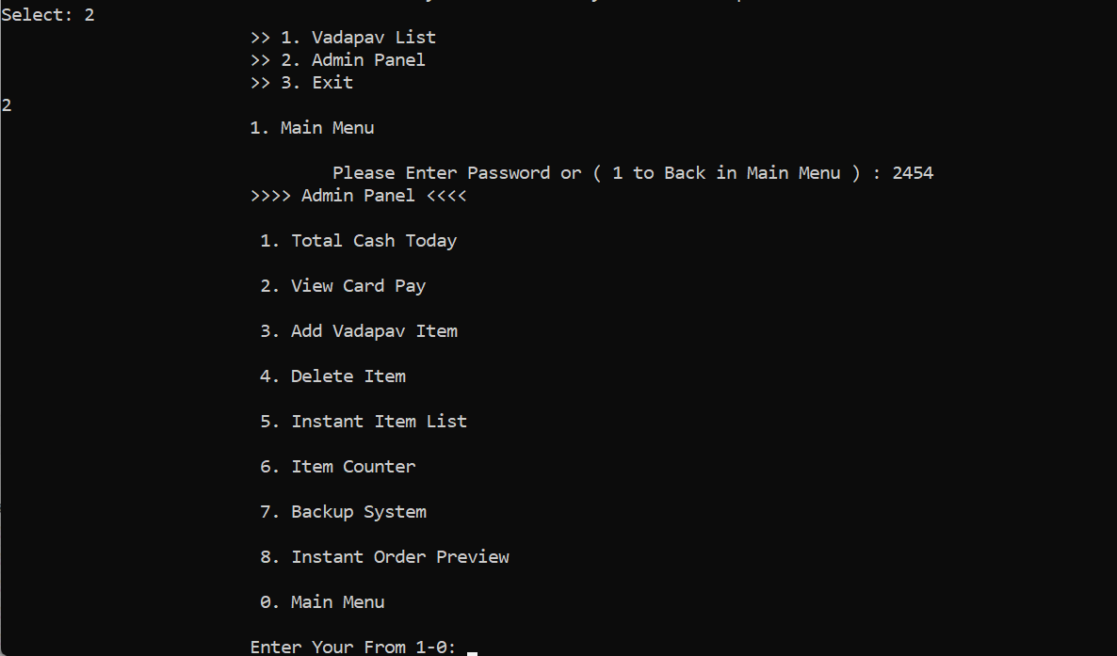
ADMIN PANEL

Slide 13
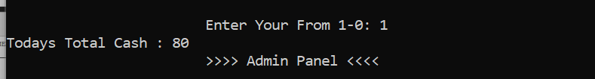
TOTAL CASH

Slide 14
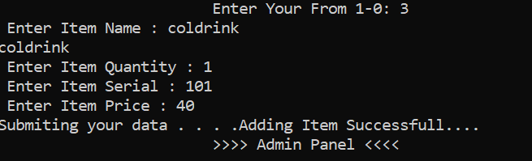
ADD ITEM

Slide 15
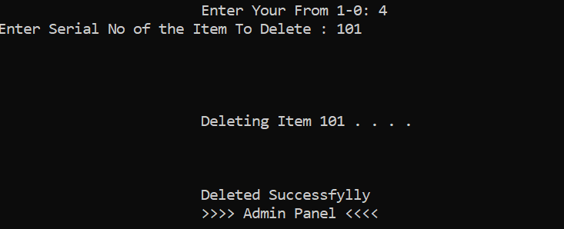
DELETE ITEM

Slide 16
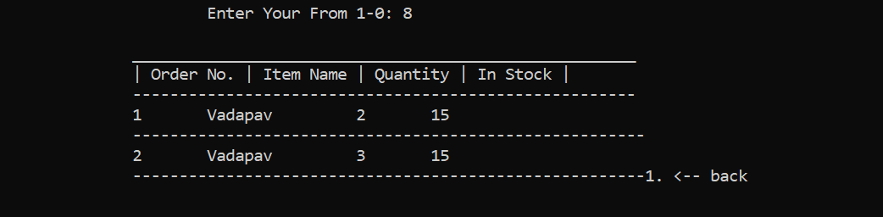
INSTANT ORDER REVIEW

Slide 17
THANKYOU

